Slide 1
Bypass & Compression Ratio
Limiting Factors and Design Tradeoffs
Abdullah Bin Masood | Advanced Concept Development | Date

Slide 2
Bypass Ratio
Fan and Core Sizing, Propulsive Efficiency

Slide 3
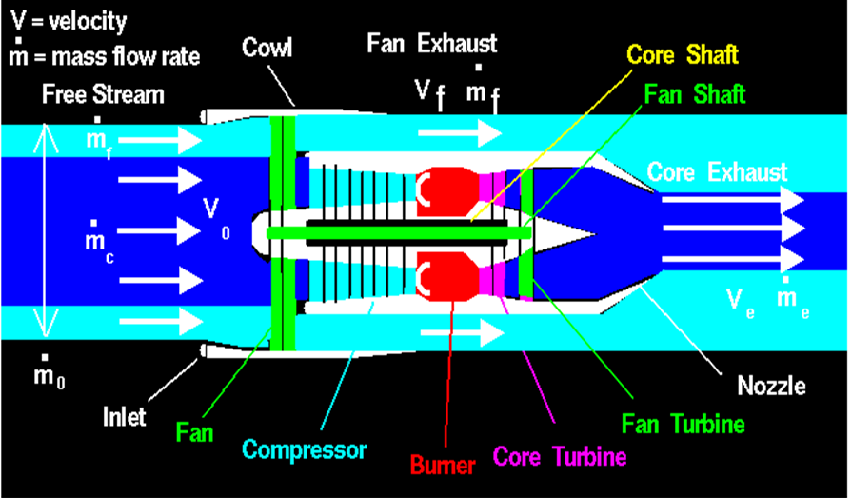
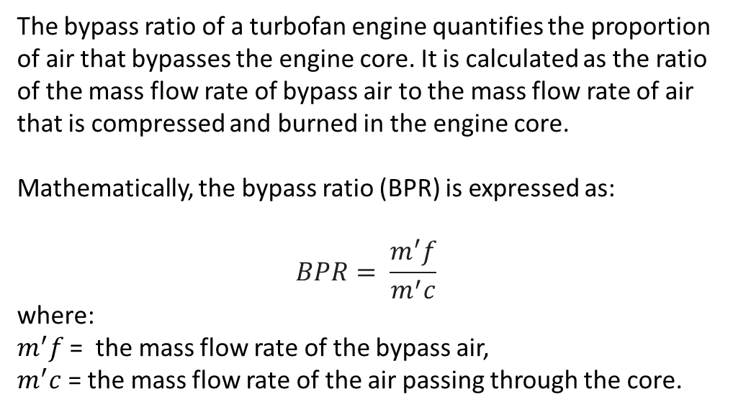
Bypass Ratio, definition
The bypass ratio of a turbofan engine quantifies the proportion of air that bypasses the engine core. It is calculated as the ratio of the mass flow rate of bypass air to the mass flow rate of air that is compressed and burned in the engine core.
Mathematically, the bypass ratio (BPR) is expressed as:
$$BPR= \frac{m^{′}f}{m^{′}c}$$
where:
$m^{′}f$= the mass flow rate of the bypass air,
$m^{′}c$ = the mass flow rate of the air passing through the core.

Slide 4
Research on Bypass ratio
Common ways of increasing bypass ratio:
Increasing the size of the fan, allowing more air to be bypassed around the core of the engine.
Using more efficient fan design , using lighter material or by optimizing the blade shape.
Reasons for increasing bypass ratio:
To reduce noise, A higher bypass ratio means that the bypass air is moving at a slower speed, which results in a quieter engine.
To improve fuel efficiency, A higher bypass ratio means that less fuel is burned, which results in lower emissions of CO2 and other pollutants.

Slide 5
Reasons for decreasing bypass ratio:
To increase thrust, A lower bypass ratio means that more air is flowing through the core of the engine, which results in more thrust.
To reduce weight, A lower bypass ratio means that the engine can be smaller and lighter, which can be important for fighter jets or other aircraft that need to be maneuverable
Considerations for narrow-body airliners:
Narrow-body airliners use high-bypass turbofans because they fly at slower speeds and need less thrust.
High-bypass turbofans are more fuel-efficient than low-bypass turbofans, which is beneficial for airliners.
Considerations for the F-35:
The F-35 uses a low-bypass turbofan engine because it needs high thrust for high speeds and stealth.
A low-bypass engine is less visible to radar than a high-bypass engine, which is beneficial for a stealthy fighter jet.

Slide 6
Limiting factors of the bypass ratio of a turbofan engine
Fan diameter: Larger fan diameter allows more air to be bypassed, but also increases size and weight.
Noise: Higher bypass ratio results in a quieter engine, but fan can still be a major source of noise.
Installation considerations (size): Larger engine can accommodate larger fan, but also heavier and more difficult to install.
Material limitations: Strong and durable materials needed for fan blades, but can be heavy.
Emissions implications: Lower fuel burn with higher bypass ratio, but bypass air can contain emissions.

Slide 7
Compression Ratio
Compressor and Combustor, Thermal Efficiency

Slide 8
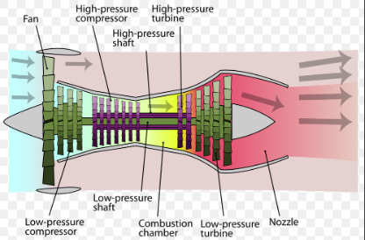
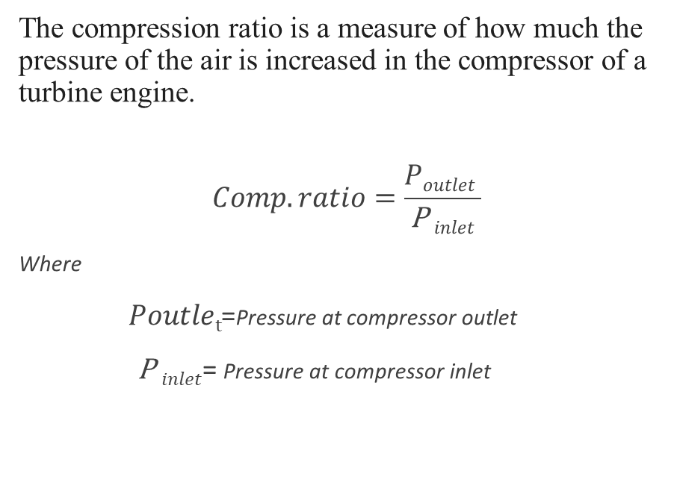
Compression ratio, definition
The compression ratio is a measure of how much the pressure of the air is increased in the compressor of a turbine engine.
$$Comp. ratio=\frac{Poutlet }{\text{P} inlet}$$
Where
$Poutlet$=Pressure at compressor outlet
$\text{P} inlet$= Pressure at compressor inlet

Slide 9
Research on Compression ratio
Common ways of increasing compression ratio:
To increase the number of compressor stages, this allows the air to be compressed more gradually, which reduces the risk of compressor surge.
To increase compression ratio is to use compressor blades with a higher camber, this means that the blades are curved more, which helps to increase the pressure of the air as it flows through the compressor.
Reason for increasing the compression ratio:
To increase the temperature of the air entering the combustion chamber, which will result in a higher flame temperature and more thrust.
To improve the efficiency of the engine, as a higher compression ratio results in a lower specific fuel consumption.

Slide 10
Limiting factors of the Compression ratio of a turbofan engine
Material strength: Blades must be strong enough to withstand high temperatures and stresses.
Temperature: Air temperature can only be increased so much before blades melt.
Number of stages: More stages means more gradual compression, reducing surge risk but increasing complexity and cost.
Blade design: Higher camber blades increase pressure but are more difficult to manufacture and may be more susceptible to failure.

Slide 11
Tradeoffs in Engine Sizing
Compressor and Combustor, Thermal Efficiency

Slide 12
Compressor:
Higher compression ratio improves efficiency but increases energy consumption.
Larger compressor size allows for better compression but adds weight and complexity.
Compressor:
Higher compression ratio improves efficiency but increases energy consumption.
Larger compressor size allows for better compression but adds weight and complexity.
Compressor:
Higher compression ratio improves efficiency but increases energy consumption.
Larger compressor size allows for better compression but adds weight and complexity.

Slide 13
The previously mentioned point give rise to the tradeoffs in Engine Sizing
Material Constraints:
Operating at higher temperatures demands advanced materials and cooling techniques.
Material choices impact engine weight, cost, and maintenance requirements.
Engine Weight and Size:
Smaller, lighter engines improve fuel consumption but might limit thrust or power.
Reducing engine size and weight affects overall performance and payload capabilities.
Time and Cost Constraints:
Developing advanced components for higher efficiency can increase design and production time.
Balancing efficiency gains with development costs is crucial for commercial viability.
Trade-offs between time, cost, and efficiency impact the feasibility of the design.

Slide 14
Thankyou

